Slide 1
Planning on R? Risk, Resources and Realism
Notes:
ABSTRACT
Safety reporting is common across all trials, and the recent initiative led by the FDA to create a standard set of safety tables and figures offers the possibility of significantly reducing the time it takes to setup safety reporting at the start of a trial, and make it easier to analyse safety signals across studies.
This presentation describes an implementation of the FDA Safety Shells that is based on a ‘building-block’ approach which allows the outputs to be created and validated quickly while also supporting study-specific customizations.
In addition to producing traditional static TFL, the outputs produce analysis results datasets based on CDISC ARS standard, which can be used to produce hyperlinked outputs in HTML and interactive reporting in R-Shiny.

Slide 2
We've been using SAS forever. Why Change?
Cheaper?
Faster to write programs?
Cost
Time
Change
Open-Source
Licenses
Recruitment
More reuse?
Quality
Open-Source
Libraries
Higher quality?
Validation?

Slide 3

“Language serves not only to express thought ..
..but to make possible thoughts which could not exist without it”
-- Bertrand Russell
Notes:
“Language serves not only to express thought but to make possible thoughts which could not exist without it” -- Bertrand Russell

Slide 4
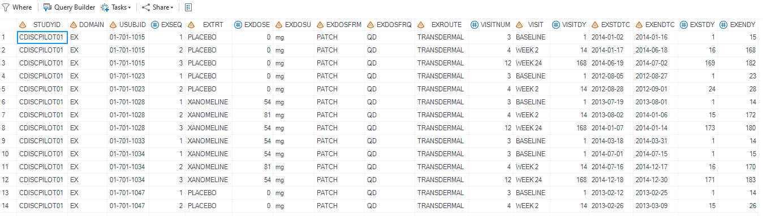
Not everything
is a table!
DATA
SORT
MERGE
PROC
DATA
SORT
Notes:
We are used to working with TABULAR DATA – even when it is not really tabular!

Slide 5
Picking the right tool for the job
Use-case | SAS | R | Python
Data Processing (Tabular) | High | Medium | Medium
Statistics | Medium | High | Medium
Graphics | Low | High | Medium
Interactive Applications | Low | Medium | High
Metadata Processing (Non-Tabular) | Low | Medium | High
API and Automation | Low | Medium | High
Third-party Libraries | Low | High | High
Clinical Data Management
Analytics & Reporting
Tools and Automation
Programming Standards

Slide 6
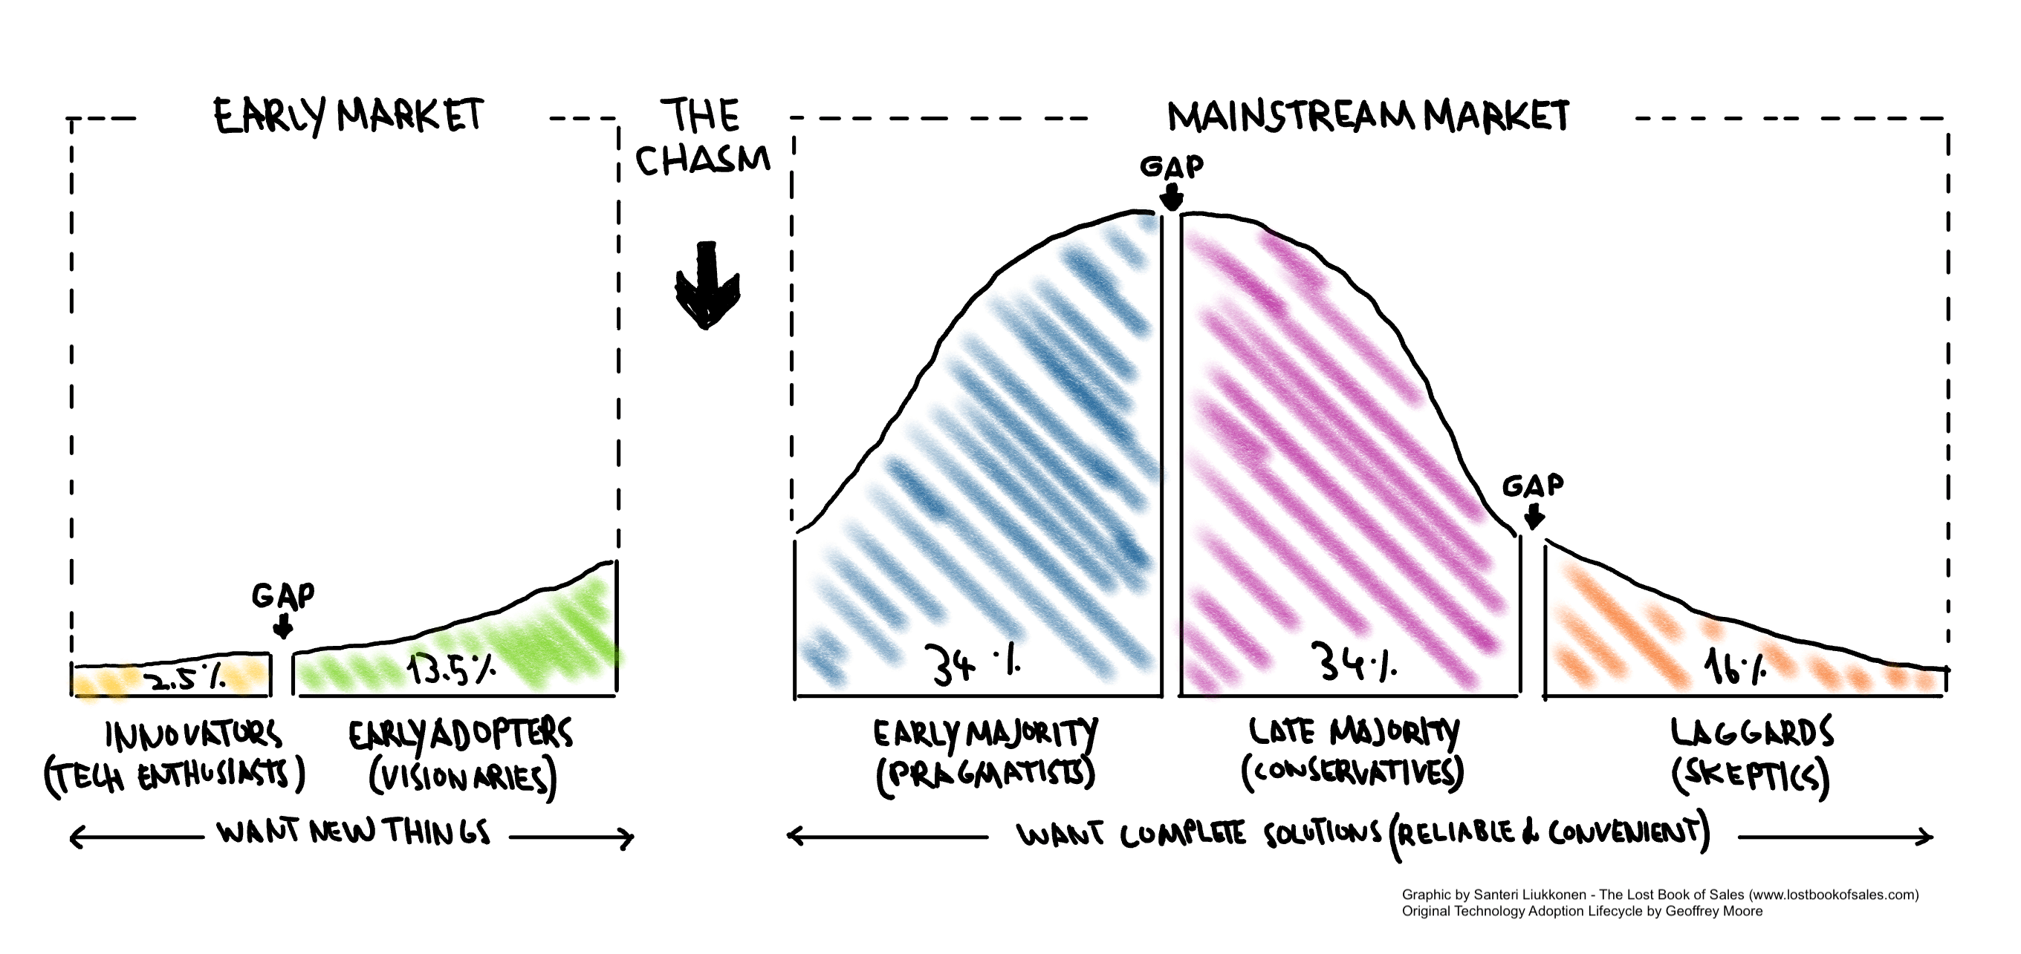
Crossing the technology adoption chasm
Tools and Automation
Clinical Data Management
Programming Standards
Analytics & Reporting

Slide 7
Crossing the technology adoption chasm
Prepare
Pilot
Migrate
Tools and Automation
Clinical Data Management
Programming Standards
Analytics & Reporting

Slide 8
Crossing the technology adoption chasm
Prepare
Pilot
Migrate
Technology
Platform / SCE
Package management
Data access
Process
SOP / WI
Guidelines
QC / Validation
People
Training
Skills
PoC projects
Experiments
Design Uncertainty
Example projects
Completed studies
Lessons learned
Training aids
Pilot projects
Blended teams
Phased handover
New studies
Systemic rollout
Office hours / support
Legacy results
Integrated/Pooled
Meta analyses
Reproducibility
Archived projects
Maintenance mode

Slide 9
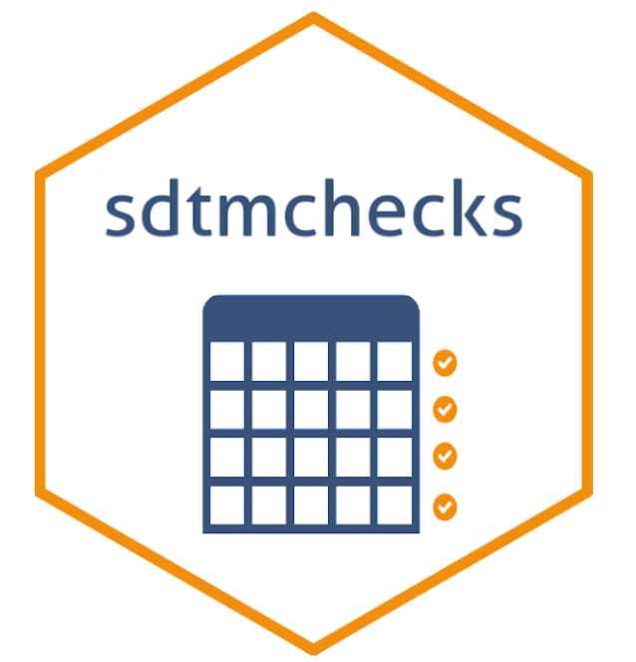













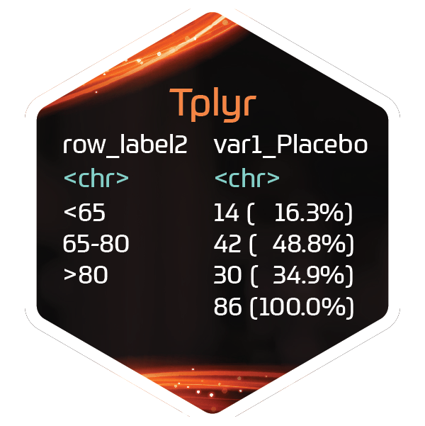












Pharmaverse: End-to-End Clinical Reporting Packages
SDTM
ADaM
TFL
Utility
https://pharmaverse.org/

Slide 10

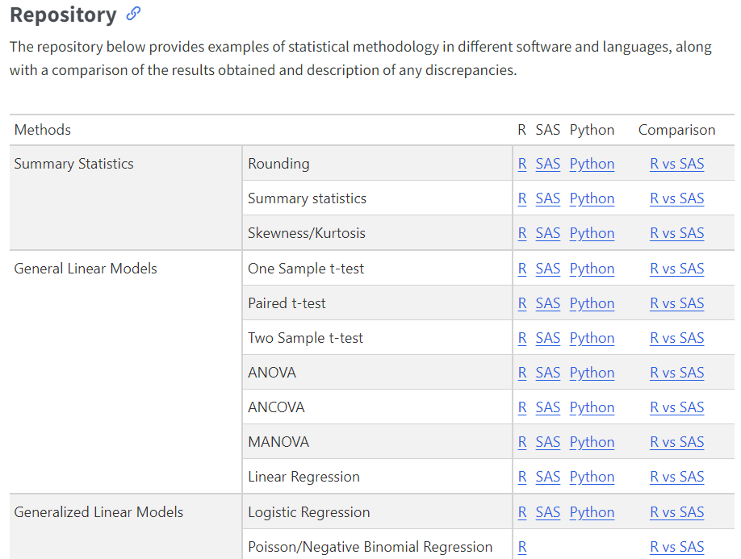

Comparing Analysis Method Implementations in Software
cross-industry PHUSE DVOST Working Group, run in collaboration with members from PHUSE, PSI, ASA and IASCT.
Why don’t I get the exact same result using different implementations of the same statistical method?
Whitepaper
https://psiaims.github.io/CAMIS/

Slide 11

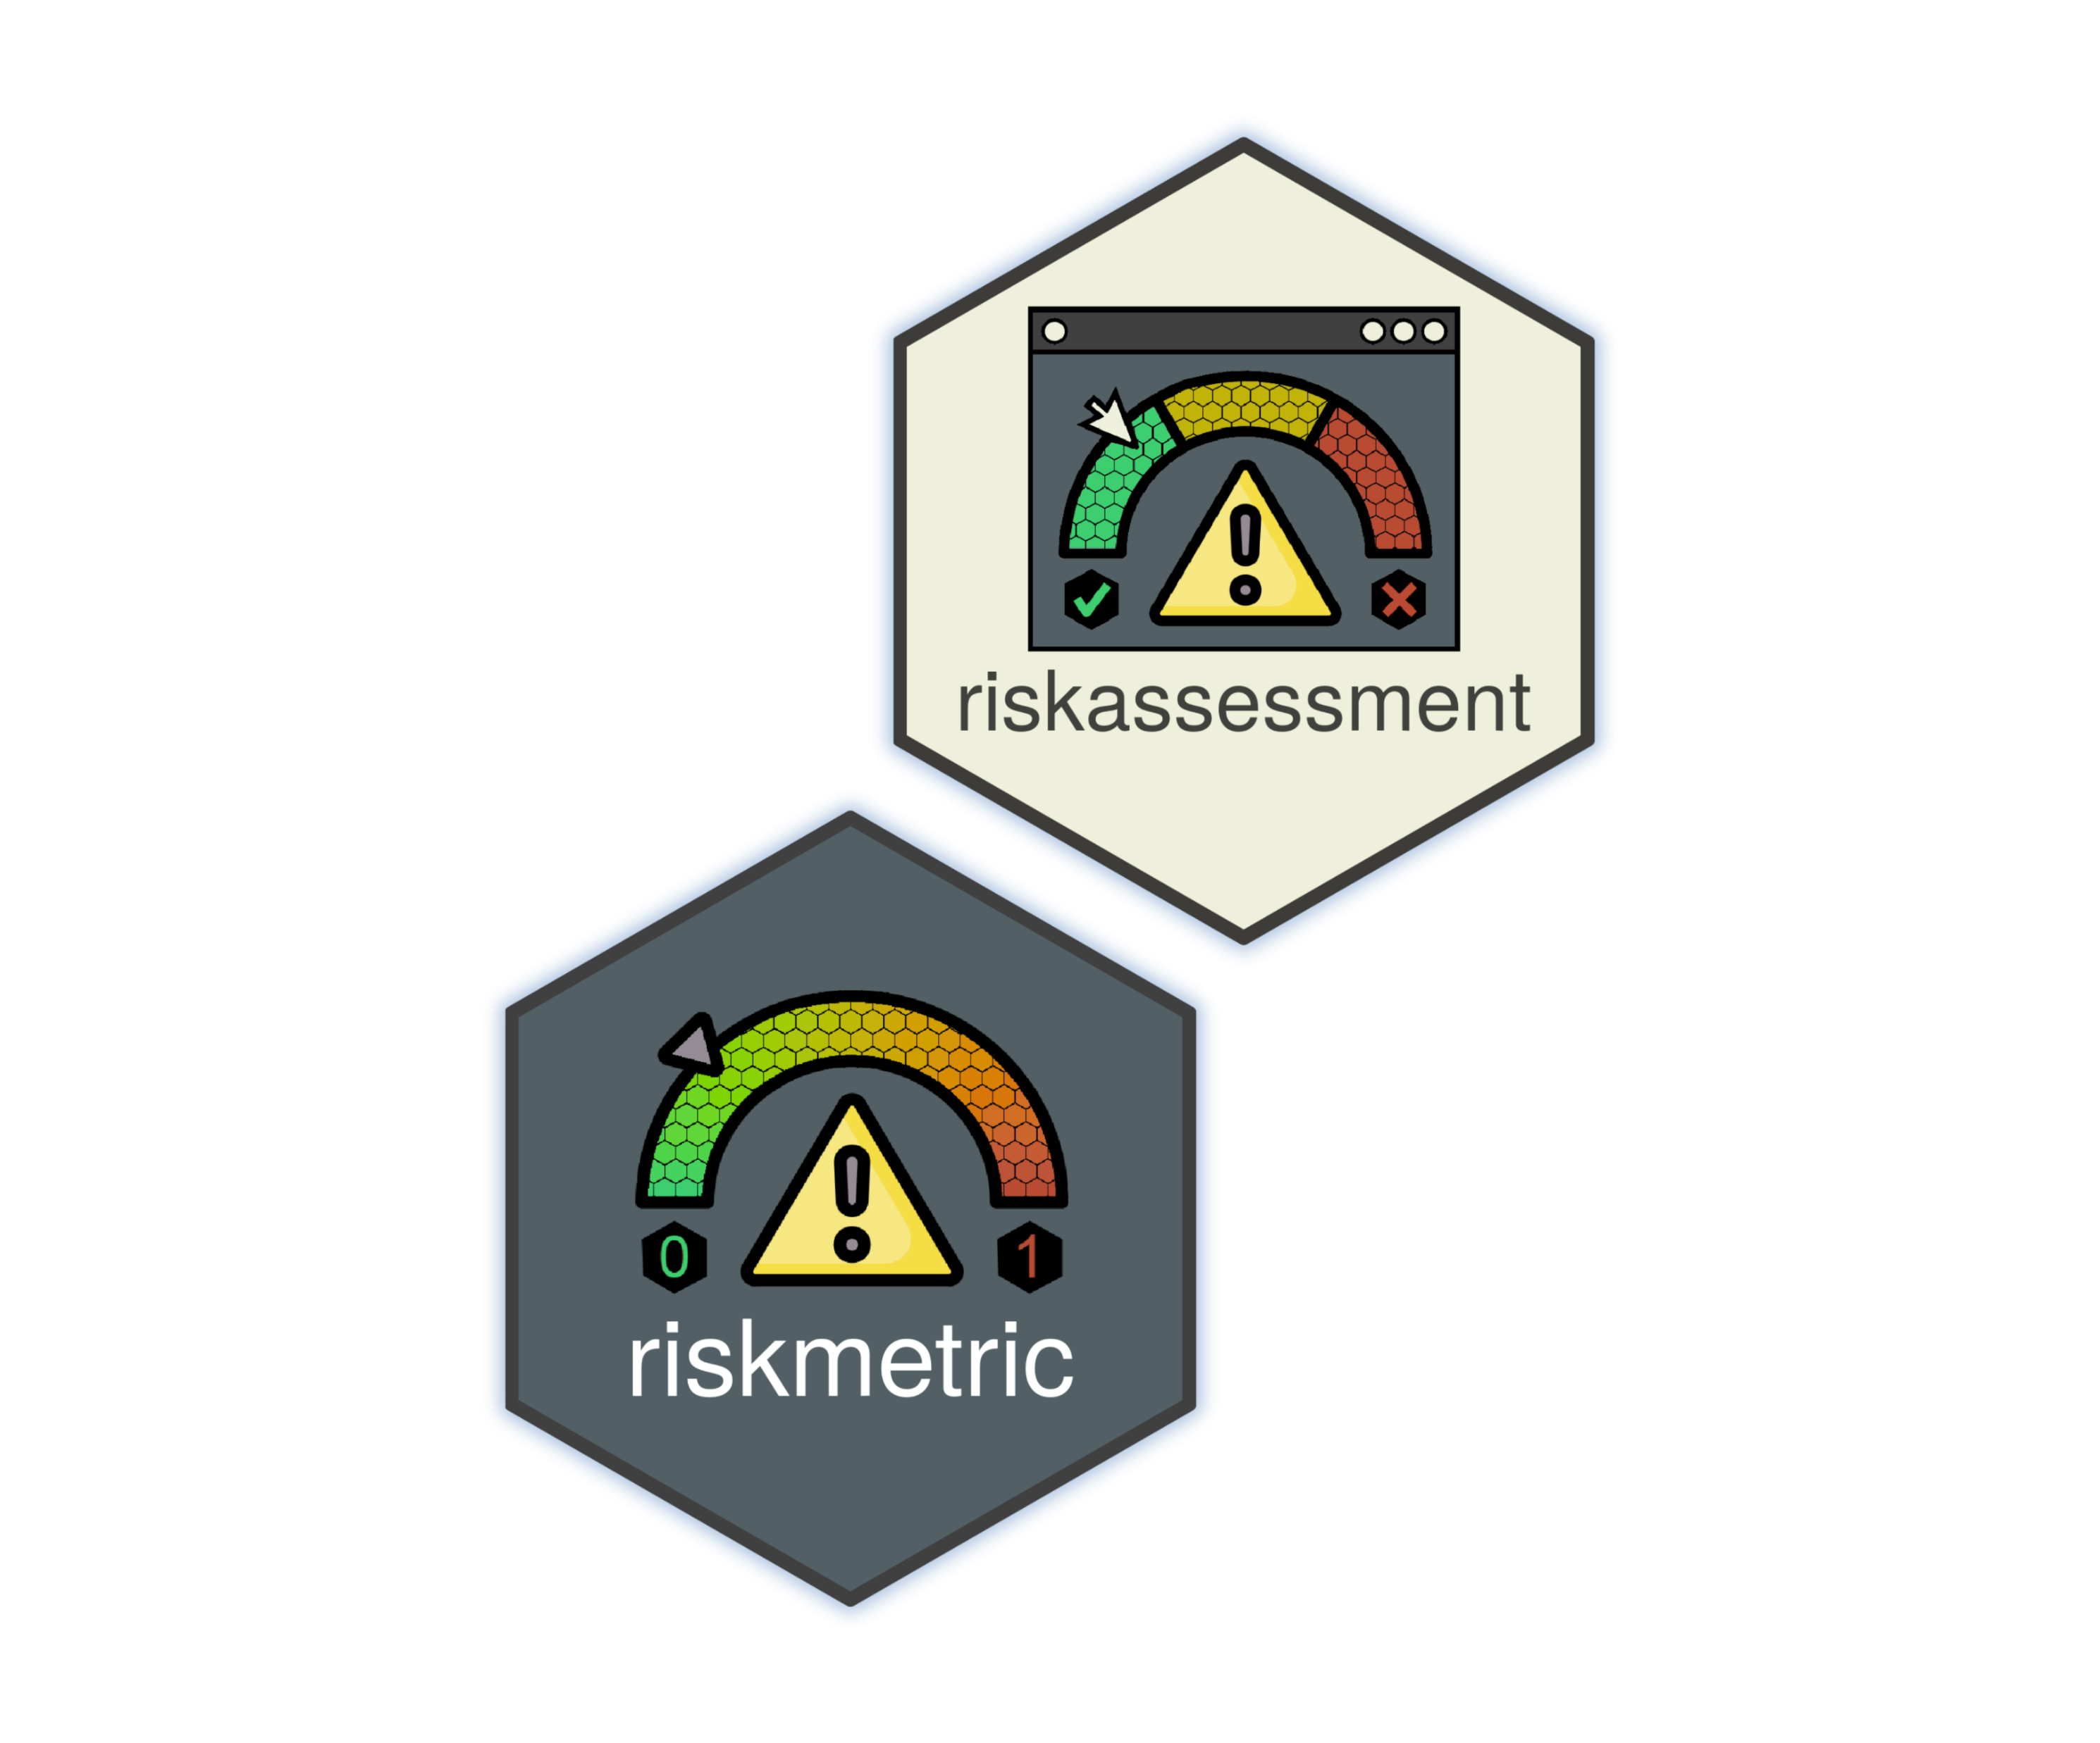

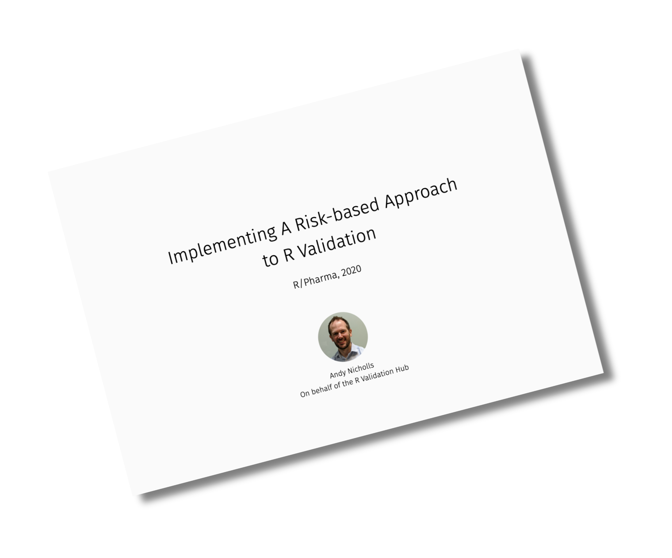

Risk-based approach to package management
formed in 2018 by the PSI AIMS Special Interest Group and is supported by the R Consortium.
Clinical Statistical Reporting in a Multilingual World
R Package Validation Framework
Andy Nicholls, Statistics Director,
Head of Statistical Data Sciences, GSK
Paulo R. Bargo, Director Scientific Computing,
Statistics & Decision Sciences, Janssen R&D
John Sims, Director, Analytical Systems Architect &
Data Science - Pfizer Vaccine Research
The {riskmetric} package, and
The {riskassessment} app
https://www.pharmar.org/

Slide 12
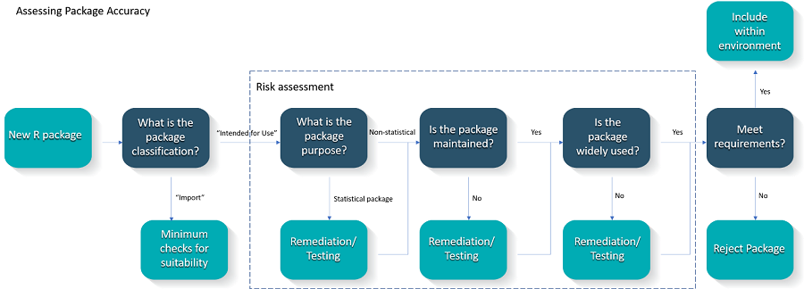
New process: A risk-based approach to R package validation

Slide 13







People, training and skills
R training for SAS programmers?
Clinical Trial training for (new) R programmers?
What about management team?
New software development lifecycle skills
Package management
Risk-based validation
Automated testing
Open-Source
Release management
Change management
Languages
& Platforms
Approved
Packages
Company
Packages &
Tools
Standards &
Processes

Slide 14
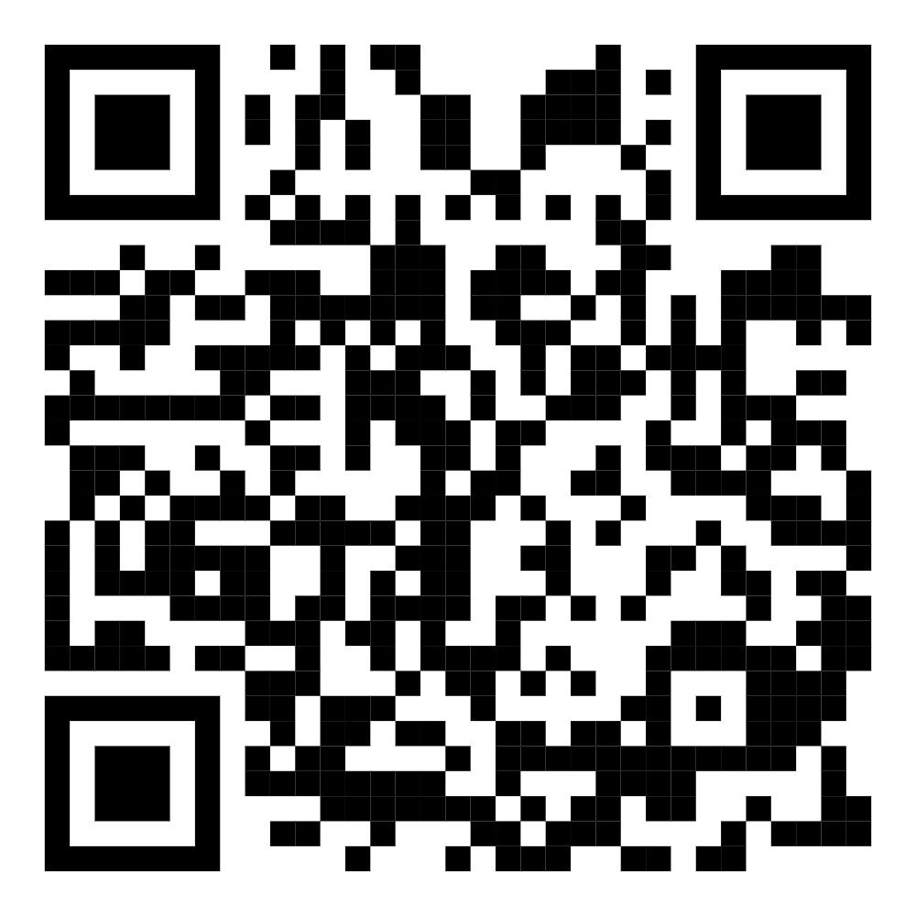
Thanks!
Questions?
Stuart.Malcolm@Veramed.co.uk
https://www.linkedin.com/in/stuart-malcolm/

